Slide 1

Hospital Management System Database
Submitted to,
Molla Rashied Hussein
Assistant Professor
Dept of CSE, UAP
April 10, 2022

Slide 2

Team Members
Name | ID
Bidita Sarkar Diba | 20101016
Jayonto Dutta Plabon | 20101022
MD. Mahmudur Rahman | 20101009
.
.

Slide 3


Introduction
The Hospital management system database is a database design for managing hospital functions and events.
It enables the admin to register a patient for the hospital, stores their disease details into the database
Admin is able to add, view, edit, update or delete data.

Slide 4
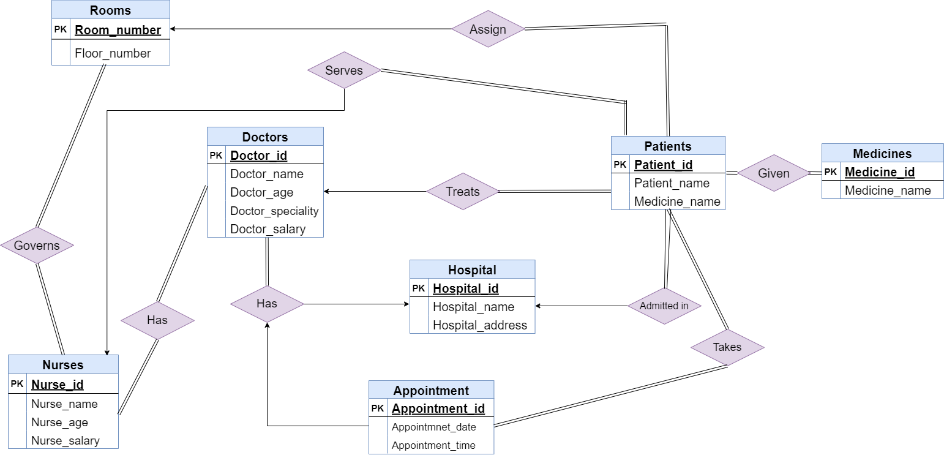
ER Diagram

Slide 5
Sample Tables with Columns
doctor_id | doctor_name | doctor_age | doctor_speciality | doctor_salary
2000 | Devi Shetty | 34 | Heart | 80000
2001 | Dr. Plabon | 29 | Kidney | 25000
2002 | Dr. Bidita | 26 | Brain | 35000
2003 | Dr. Mahmud | 30 | Liver | 40000
2004 | Dr. Rahman | 38 | Skin | 45000
2005 | Dr. Diba | 40 | Heart | 65000
Medicine_id | Medicine_name
01 | Napa
02 | Seclo
03 | Napa Rapid
04 | Fexo
05 | E-Cap

Slide 6
Sample Tables with Columns
Nurses_id | Nurses_name | Nurses_age | doctor_name | Nurses_salary
1011 | Rina | 23 | Dr. Diba | 65000
1012 | Nipa | 25 | Dr. Plabon | 22000
1013 | Riya | 22 | Dr. Rahman | 22000
1014 | Nila | 33 | Dr. Mahmud | 35000
1015 | Popy | 43 | Dr. Devi Shetty | 26000
1016 | Rima | 45 | Dr. Bidita | 33000
1017 | Mim | 36 | Dr. Mahmud | 33000
1018 | Anny | 39 | Dr. Devi Shetty | 55000
Appointment_id | Appoinment_date | Appointment_time
123001 | 12-04-2022 | 10:00 AM
123002 | 12-04-2022 | 12:00 AM
123003 | 13-04-2022 | 10:00 AM
123004 | 13-04-2022 | 12:00 AM
123005 | 14-04-2022 | 12:00 AM
123006 | 15-04-2022 | 10:00 AM

Slide 7
Sample Tables with Columns
Patient_id | Patient_name | doctor_name | Nurse_name | medicine_name | room_num
111 | Apon | Dr. Diba | Rina | Napa | 201
112 | Badshah | Dr. Rahman | Riya | Fexo | 103
113 | Alam | Dr. Devi Shetty | Anny | Seclo | 301
114 | Mina | Dr. Bidita | Rima | E-cap | 202
115 | Raju | Dr. Devi Shetty | Popy | Napa Rapid | 102
116 | Arnob | Dr. Plabon | Nipa | Napa | 303
117 | Turjo | Dr. Mahmudur | Mim | Napa Rapid | 302
118 | Fuad | Dr. Mahmudur | Nila | Seclo | 101
Hospital_id | Hospital_name | Hospital_address
10001 | United Hospital | Dhanmondi, Dhaka
10002 | BRB Hospital | Gulshan, Dhaka
10003 | Apollo Hospital | Baridhara, Dhaka
10004 | Square Hospital | Panthopath, Dhaka

Slide 8
Sample Tables with Columns
room_num | floor_num
101 | 1
102 | 1
103 | 1
201 | 2
202 | 2
203 | 2
301 | 3
303 | 3
401 | 4
402 | 4

Slide 9



